Slide 1
Query Languages for Data
Pravin Y Pawar
Adapted from Designing Data Intensive Applications by Martin Kleppmann

Slide 2
Query Languages for Data
Common ways of querying data
Declarative queries
Imperative code
When the relational model was introduced, it included a new way of querying data:
SQL is a declarative query language
whereas IBM IMS and CODASYL queried the database using imperative code

Slide 3
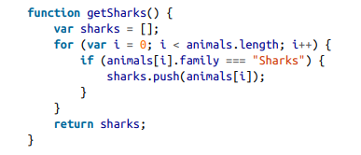

Imperative code vs Declarative queries
Many commonly-used programming languages are imperative.
For example, following code retrieves the sharks from the list of animals
In the relational algebra, you would instead write:
where σ is the selection operator, returning only those animals that match the condition family = “Sharks”
When SQL was defined, it followed the structure of the relational algebra fairly closely:

Slide 4
Imperative code vs Declarative queries(2)
In Imperative language
instructs the computer to perform certain operations in a certain order
stepping through the code, line by line,
evaluating conditions
updating variables
and deciding whether to go around the loop one more time
In a declarative query language, like SQL or relational algebra,
specify the pattern of the data is needed
what conditions the results must meet,
how you want it to be transformed e.g. sorted, grouped and aggregated
but not how to achieve that goal
Up to the database system’s query optimizer to decide
which indexes and which join methods to use
in which order to execute various parts of the query

Slide 5
Imperative code vs Declarative queries(3)
A declarative query language is attractive because
it is typically more concise and easier to work with than an imperative API
More importantly, it also hides implementation details of the database engine
makes it possible for the database system to introduce performance improvements without requiring
any changes to queries
For example, in the imperative code, the list of animals appears in a particular order
If the database wants to reclaim unused disk space behind the scenes
it might need to move records around, changing the order in which the animals appear
Can not be done by the database safely with imperative code
The SQL doesn’t guarantee any particular ordering, and so it doesn’t mind if the order changes
But if the query is written as imperative code, the database can never be sure whether the code is
relying on the ordering or not
The fact that SQL is more limited in functionality gives the database much more room for automatic
optimizations

Slide 6
Imperative code vs Declarative queries(4)
Today, CPUs are getting faster by adding more cores
not by running at significantly higher clock speeds than before
Imperative code is very hard to parallelize across multiple cores and multiple machines
because it specifies instructions that must be performed in a particular order
Declarative languages often lend themselves to parallel execution
specify only the pattern of the results, but not the algorithm that is used to determine the results
database is free to use a parallel implementation of the query language, if appropriate

Slide 7
MapReduce querying
Programming model for processing large amounts of data in bulk across many machines,
popularized by Google
A limited form of MapReduce is supported by some NoSQL data stores MongoDB and CouchDB
as a mechanism for performing read-only queries across many documents
MapReduce is neither a declarative query language, nor a fully imperative query API, but somewhere in between!
the logic of the query is expressed with snippets of code, which are called repeatedly by the
processing framework
based on the map (also known as collect) and reduce (also known as fold or inject) functions that exist
in many functional programming languages

Slide 8
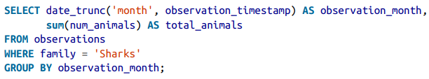
MapReduce querying(2)
For example, imagine you are a marine biologist, and you add an observation record to your
database every time you see animals in the ocean
Now you want to generate a report saying how many sharks have been sighted per month
In PostgreSQL you might express that query like this:
This query
first filters the observations to only show species in the Sharks family
then groups the observations by the calendar month in which they occurred
and finally adds up the number of animals seen in all observations in that month

Slide 9
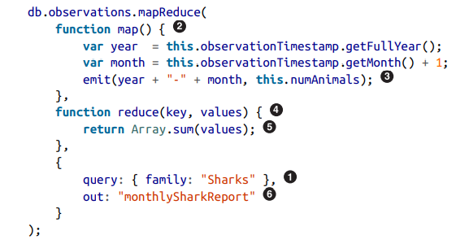
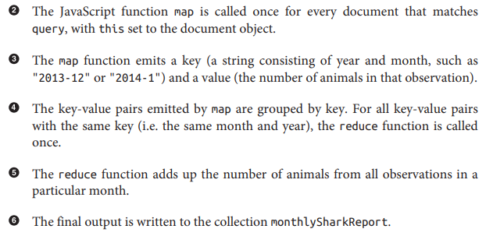
MapReduce querying(3)
The same can be expressed with MongoDB’s MapReduce feature as follows

Slide 10
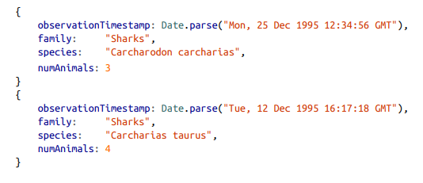
MapReduce querying(4)
For example, say the observations collection contains these two documents:
The map function would called once for each document, resulting in
emit("1995-12", 3)
emit("1995-12", 4)
Subsequently, the reduce function would be called with
reduce("1995-12", [3, 4]), returning 7.

Slide 11
MapReduce querying(5)
The map and reduce function are somewhat restricted in what they are allowed to do
Must be pure functions
only use the data that is passed to them as input
cannot perform additional database queries
must not have any side-effects
Restrictions allow the database to run the functions anywhere, in any order, and re-run them on failure
However, they are nevertheless powerful
parse strings
call library functions
perform calculations and more

Slide 12
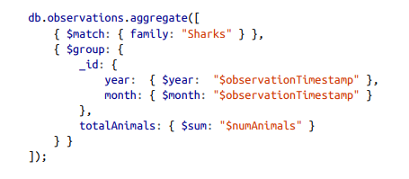
MapReduce querying(6)
MapReduce is a fairly low-level programming model for distributed execution on a cluster of machines
A usability problem with MapReduce is need to write two carefully coordinated functions
often harder than writing a single query
Higher-level query languages like SQL can be implemented as a pipeline of MapReduce operations
A declarative query language offers more opportunities for a query optimizer to improve the performance of a query
MongoDB added support for a declarative query language called aggregation pipeline
The aggregation pipeline language’s expressiveness
is similar to a subset of SQL,
but it uses a JSON-based syntax rather than SQL’s English-sentence-style syntax
The moral of the story is that a NoSQL system may find itself
accidentally reinventing SQL, albeit in disguise

Slide 13
Thank You!
In our next session:

